Slide 1
Key findings
We revealed unexpected formation of 1D metal-organic chains (MOC) comprised of circumcoronene monomers coordinated by single Cu adatoms on Cu(111) surface.
MOC formation implies unusual highly-efficient and regioselective activation C-H bonds located at zigzag edges.
With aid of CO-functionalized imaging we confirm presence of single Cu coordination atom and bent geometry of the circumcoronene monomers.
dI/dV imaging with CO-tip enabled resolution of frontier orbitals (HOMO, LUMO and [LUMO+1]) and their hybridization with Cu adatom states (HOMO+Cu and [LUMO+1]+Cu).
We observe reversible transformation of MOC to individual circumcoronene molecules upon annealing in atomic H flux.
Stability and formation of MOC is driven by cooperative effect of i) lowered barrier for C-H bond dissociation facilitated by presence of Cu adatom ; ii) unique molecule’s symmetry and aromaticity (7 Clar’s sextets) reinforcing its ability to accommodate strained bent geometry within MOC registered with Cu(111) substrate.
Notes:
Q (JH): Previous image shows coordinated by 3 Cu atoms? See the other PPT on slides 1 and 3.

Slide 2
Cu
Cu
270C
1 hour
T>>270C
Cu
Or prolonged annealing
M. Telychko, G. Li et al Science Advances 7(3), eabf0269, 2021
Cu
Cu
Notes:
Dimerization vs. polymerization?

Slide 3
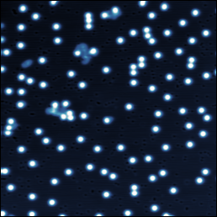
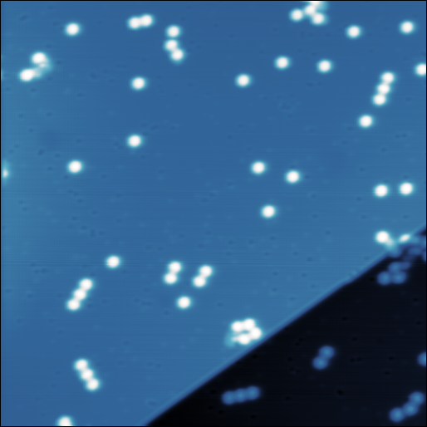
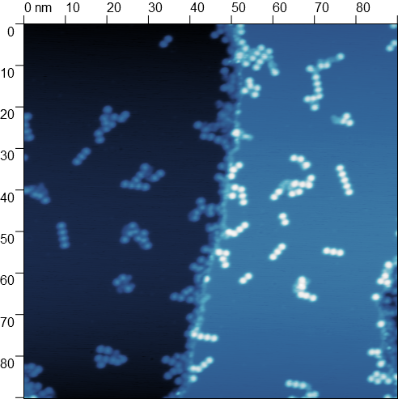
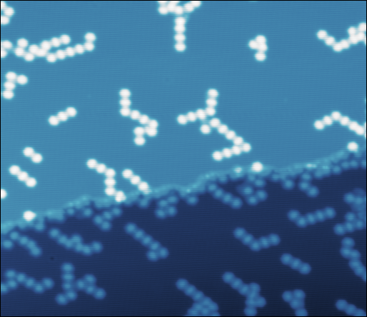
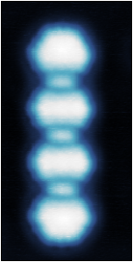
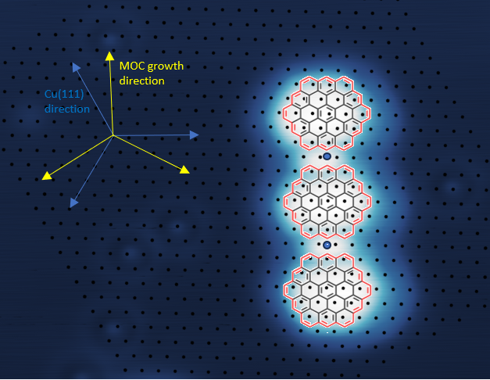
Formation of circumcoronene-based Cu-coordinated metal-organic (MOC) chains
MO dimer
275C
2 hours
310C
2 hours
120⁰
60x60nm, 1V, 500pA
60x60nm, 1V, 500pA
90x90nm, 1V, 1nA
270C
Overnight anneal
(14 hours)
1V, 1nA 60x50nm
Notes:
There is good C6-Cu registry.

Slide 4
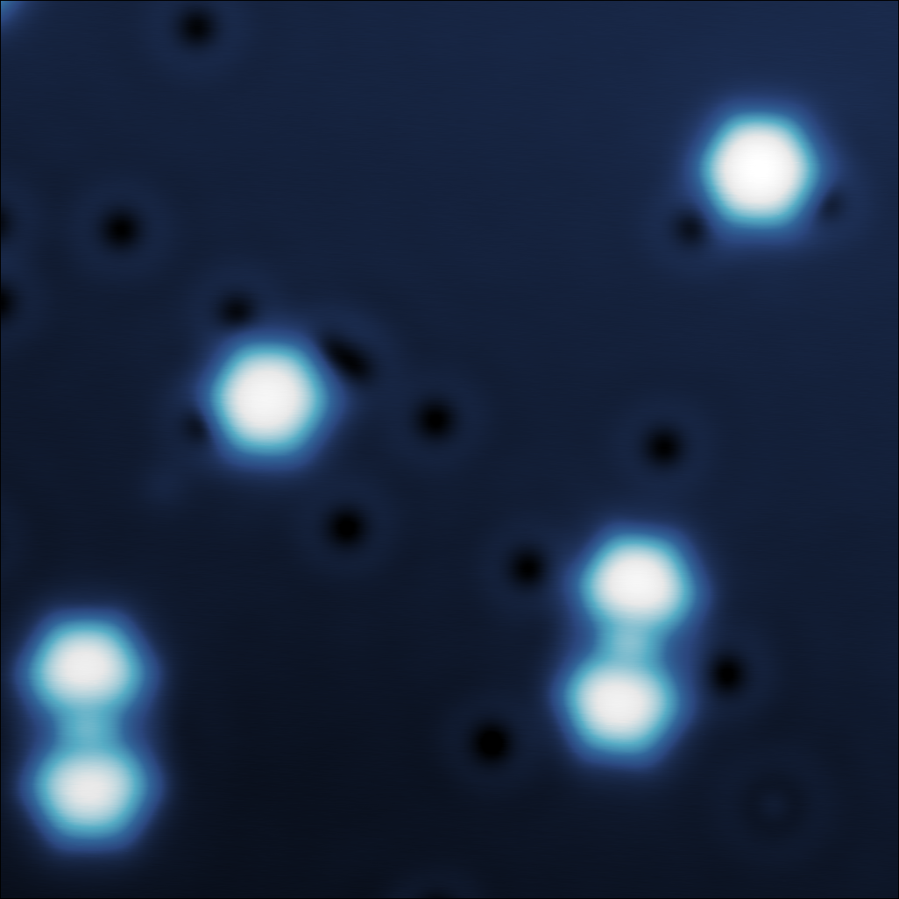
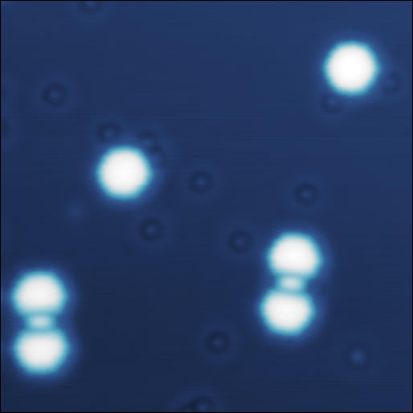
Metallic tip
CO tip
CO absorbed
Circumcoronene
c
o
CO
CO
MO dimer
13x13nm, .9V, 1.5nA
13x13nm, 1V, 1nA
Notes:
Dimer shows an offset; really dimerized with Cu in between? No offset with a little rotation.

Slide 5
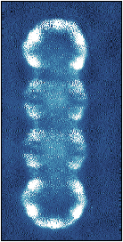
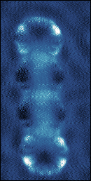
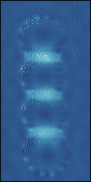
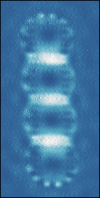
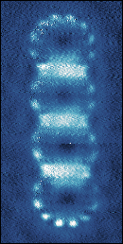
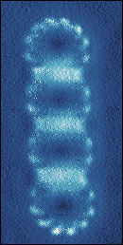
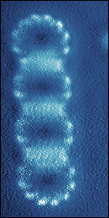
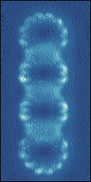
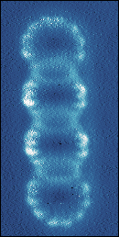
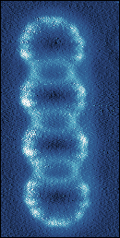
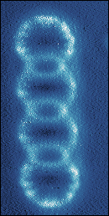
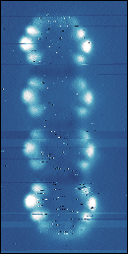
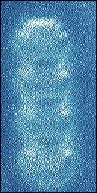
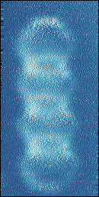
dI/dV mapping with CO-tip: HOMO, HOMO+Cu, LUMO, [LUMO+1]+Cu, LUMO+1
dI/dV@0.7V
0.9V
1.15V
1.25V
1.35V
1.45V
1.50V
1.60V
1.70V
1.80V
1.90V
-1.60V
-1.30V
-1.40V

Slide 6
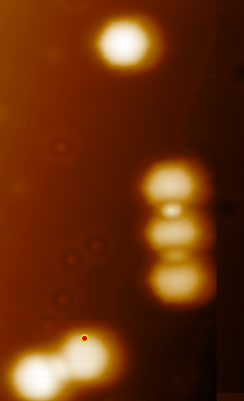
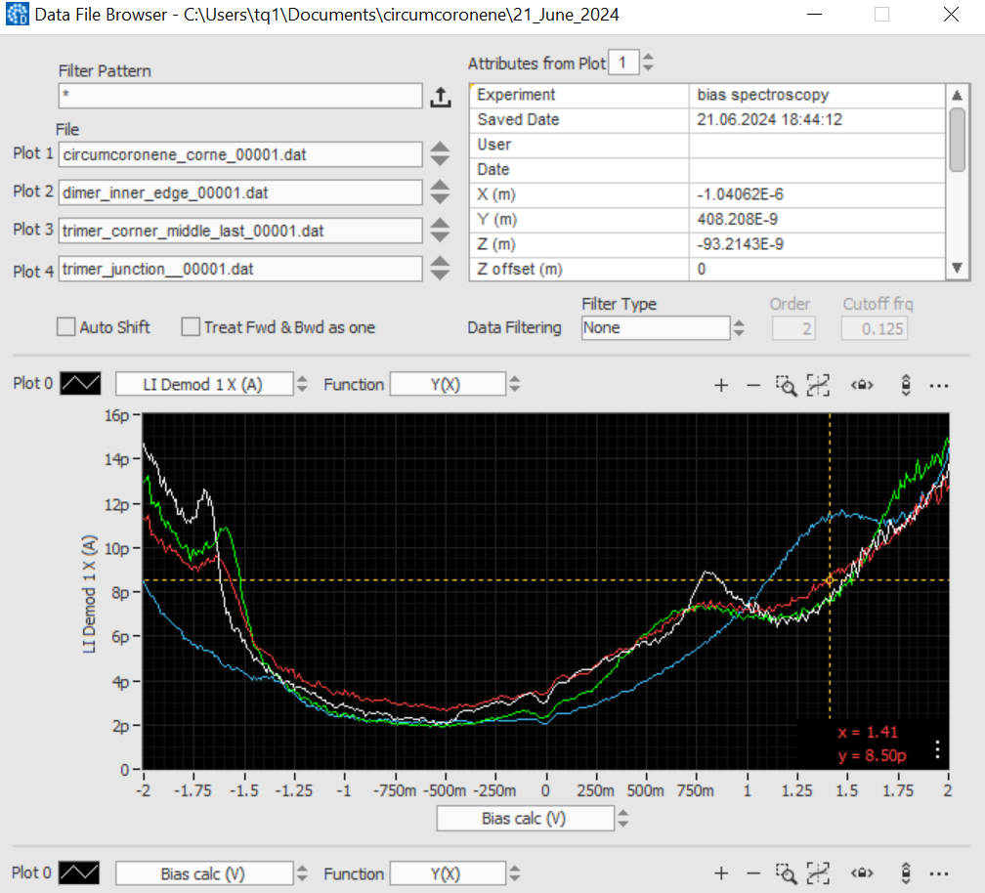
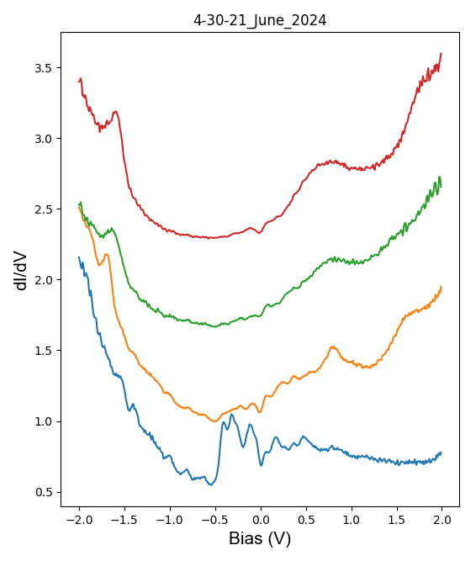
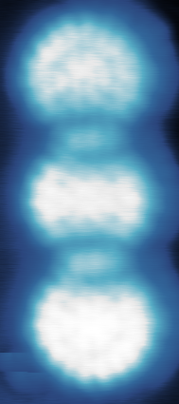
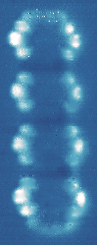
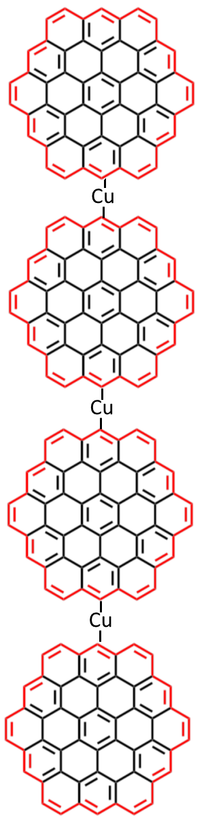
dI/dV → HOMO, LUMO and LUMO+1 “circumcoronene” orbitals
HOMO (V) | LUMO
-1.7 | 0.82
-1.65 | 0.73
-1.6 | 0.68
-1.6 | 0.68
HOMO
LUMO
LUMO+1
Circ.
Dimer
Trimer
Trimer
Teramer
Topo.
dI/dV @HOMO
dI/dV @LUMO
dI/dV @ LUMO+1
Dimer
Circumcoronene
Cu(111)

Slide 7
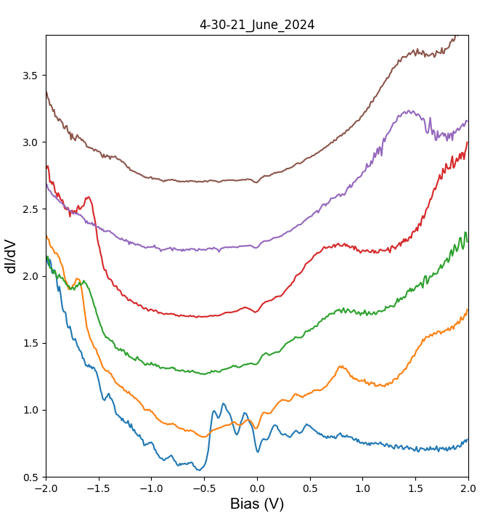
dI/dV → additional states derived from HOMO/(LUMO+1) orbitals and Cu adatom d orbitals.
HOMO+ Cu
[LUMO+1]+Cu
Trimer
dI/DV
@ HOMO+ Cu
dI/dV
(LUMO+1) + Cu
1.25V
Dimer
Circumcoronene
Cu(111)

Slide 8
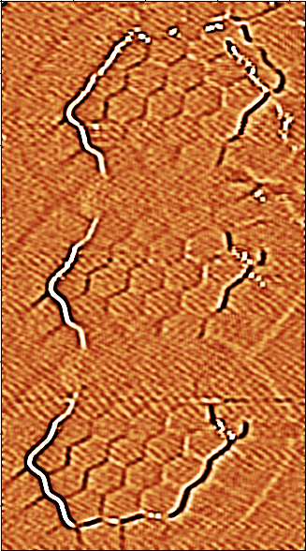
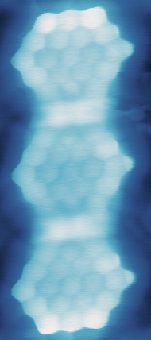
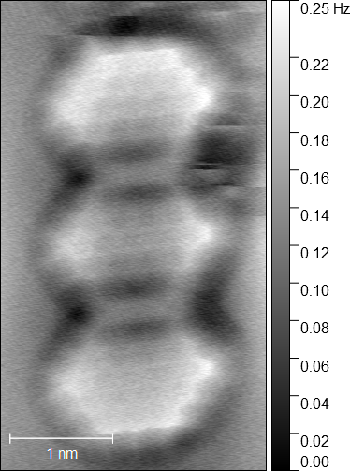
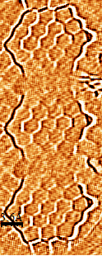
Laplace filtered Current channel
Laplace filtered Current channel
Bond resolved imaging -> molecules adopt bent concave-like geometry
Constant-current STM
Constant. Current ncAFM
Cu
Cu
50mV, 0.4nA

Slide 9
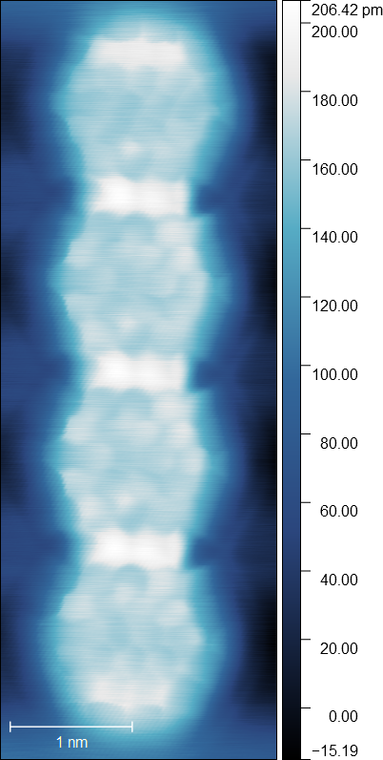
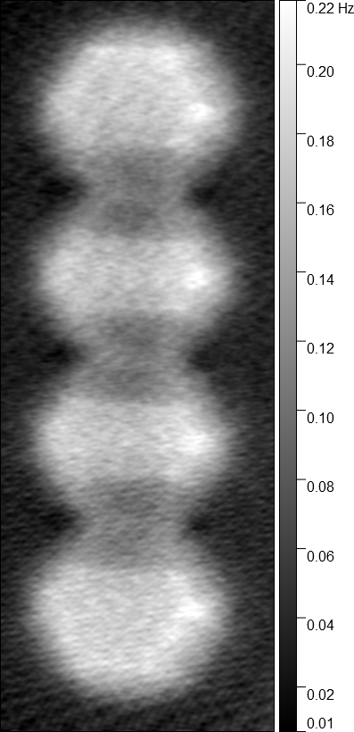
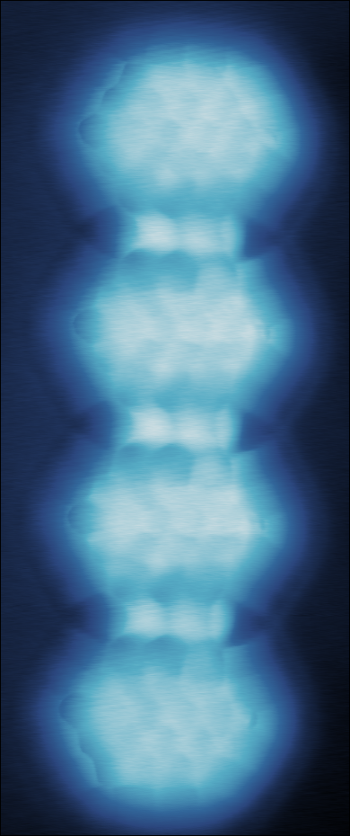
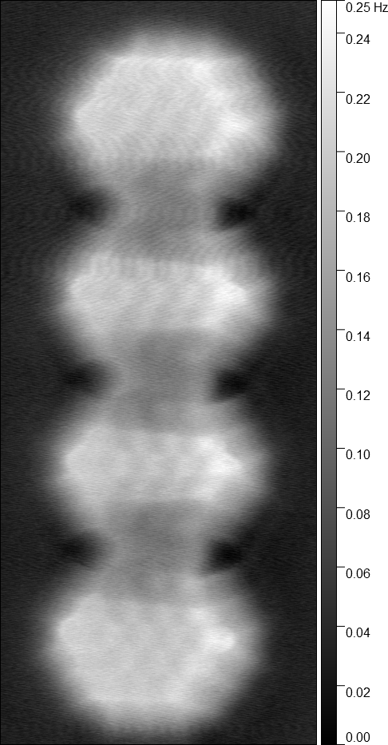
Bond resolved imaging -> molecules adopt bent concave-like geometry
Constant-current STM
Constant-current ncAFM
Const. Current ncAFM
100mV, 0.5nA
70mV, 0.5nA

Slide 10
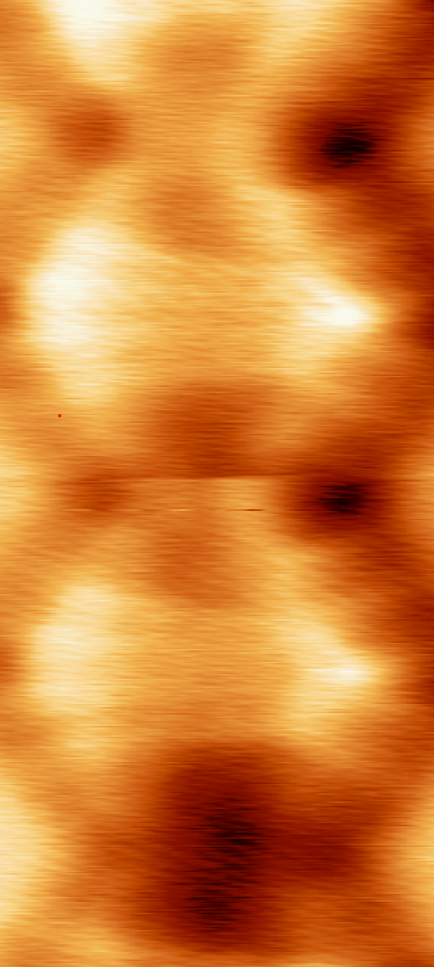
Bond resolved imaging -> molecules adopt bent concave-like geometry
Constant current STM Constant currentncAFM
Constant height ncAFM

Slide 11
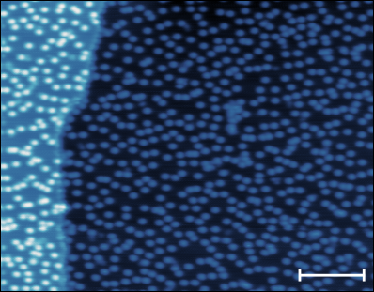
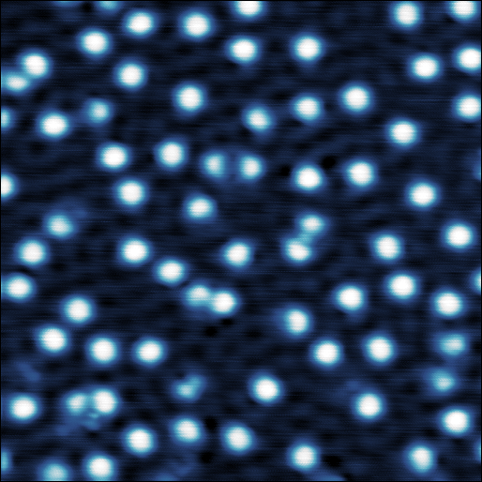
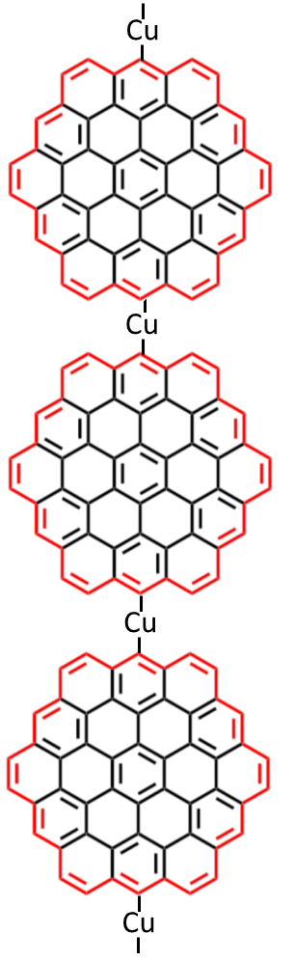
Annealing with atomic H flux -> reversible transformation of MO chains to individual circumcoronenes
Before
After (same sample annealed @ 270C + atomic H)
1V, 1nA 60x50nm
270C +
atomic H
1V, 1nA 30x30nm
20nm
270C +
atomic H
Notes:
What calculations should we perform to differentiate from the Mykola’s previous Angew Chem and Sci Adv papers?

